Slide 1
Dissertation Stage-II (PHN-600B) Mid-Term Presentation Supervisor – Dr H S Nataraj
Laksh Arora
20615013

Slide 2
Topic To solve the Dirac Equation for many electron atoms using Dirac Hartree Fock Self Consistent Field method

Slide 3
Dirac Hartree Fock Theory

Slide 4
N-electron Dirac Hamiltonian
We are interested in finding a set of spin orbitals such that the single determinant formed from these spin orbitals is the best approximation to the ground state of an N-electron system.
The total Dirac-Breit Hamiltonian for a many electron system has two terms- a one-electron part consisting of kinetic, mass-energy and nuclear attraction:
And the two electron part, consisting of Coulomb repulsion and Breit Interaction (which I am not considering for now):

Slide 5
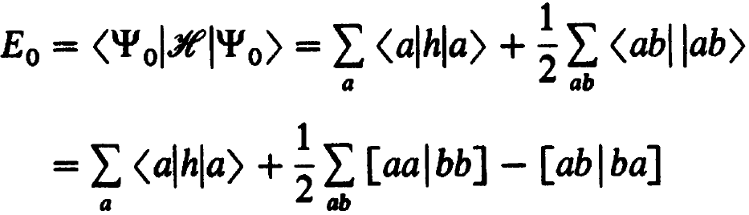
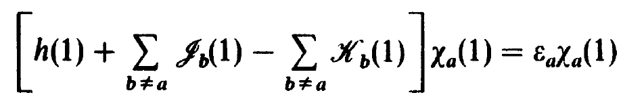
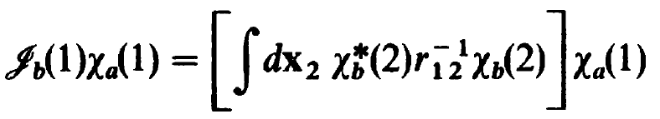
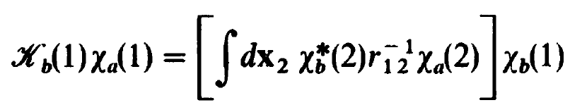
Hartree-Fock Equations
According to the variational principle, the ‘best’ spin orbitals are those which minimize the electronic energy
The resulting equation is the Hartree Fock Integro-differential equation
where, h = one electron operator
J = direct coulomb operator
K = exchange coulomb operator

Slide 6




Hartree-Fock Equations
Considering,
We can add this to the previous equation and define the fock operator as
So that the Hartree Fock equation becomes
Keep in mind that we are not solving the exact electronic Schrodinger equation but rather we have used the variational principle to find an approximation.
Therefore, the sum of orbital energies we get as a result is not the total energy. The orbital energies are actually negative of the ionisation potentials required to remove the corresponding electrons (Koopmans’ theorem).

Slide 7
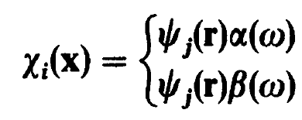

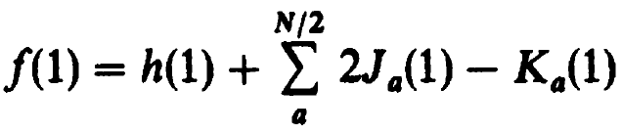
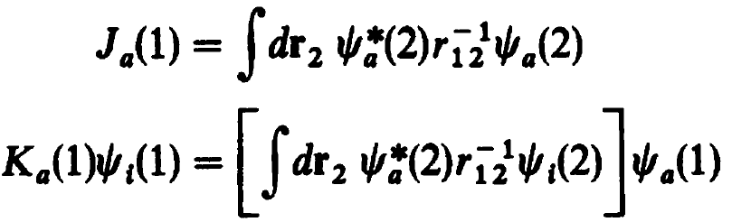
Restricted Closed shell Hartree-Fock: Roothaan Equations
Only even number of electrons such that all spatial orbitals are doubly occupied.
Integrating over spin

Slide 8
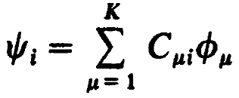
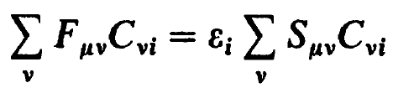



Basis
We introduce a set of known basis functions and write our unknown spatial orbitals as a linear combination of these spin orbitals.
Substituting this into the Roothaan equations, we get
Where, F is the fock matrix
S is the overlap matrix
This is more compactly written as a single matrix equation
Where C is a matrix of the expansion coefficients, e is a diagonal matrix of the orbital energies.

Slide 9

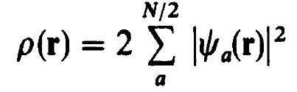
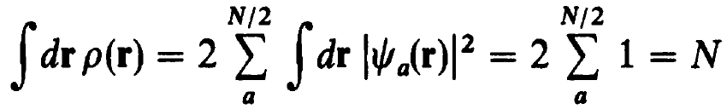
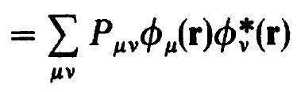

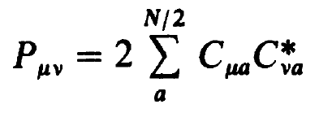
Density Matrix
The probability of finding an electron in a volume element dr at point r is
Therefore, the total charge density
,
Inserting the basis set function into the expression for charge density, we get
where, This is called the density matrix.
Since P is directly related to the expansion coefficients C, the spatial orbitals can be characterized by either C or P.

Slide 10
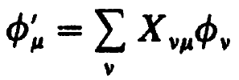




Orthogonalisation of basis
The basis functions are normalized but not orthogonal, giving rise to the overlap matrix S leading to a pseudo eigen value problem.
If we can orthogonalize the basis functions, S will be an identity matrix. This puts Roothaan equations into the form of the usual matrix eigenvalue problem.
We need to find a transformation matrix X such that form an orthogonal set, i.e.,
Canonical Orthogonalisation:
, where ,where s is a diagonal eigenvalue matrix.
That is, the columns of the unitary matrix U are divided by the square root of the corresponding eigenvalue.

Slide 11





Orthogonalisation of basis
Consider a new coefficient matrix
Define a new matrix
This equation now can be solved as a usual eigen value problem given F. Given C’, C can be obtained using the above relations

Slide 12
SCF Procedure
Specify the atom and basis set.
Calculate the overlap matrix S. Diagonalise to get transformation matrix X.
Guess the Coeffient Matrix C and density matrix P.
Calculate F, F’.
Diagonalise F’ to obtain C’.
Calculate C.
Form new density matrix P.
Check if the procedure has converged by comparing the new density matrix with the previous. If not, return to step 4.
If there is convergence, use the resultant solution C, P, F to calculate various quantities of interest.

Slide 13
Code - Theory

Slide 14
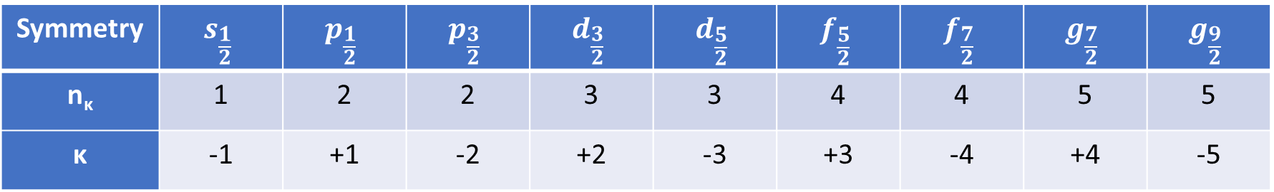
Basis
In the central field approximation, the solution to the Dirac equation is given by four component spinors:
Where P and Q are the large and small component of the radial wave function, while χ is the spin angular part.
κ defines the orbital symmetry is given by:
Symmetry | $$s_{\frac{1}{2}}$$ | $$p_{\frac{1}{2}}$$ | $$p_{\frac{3}{2}}$$ | $$d_{\frac{3}{2}}$$ | $$d_{\frac{5}{2}}$$ | $$f_{\frac{5}{2}}$$ | $$f_{\frac{7}{2}}$$ | $$g_{\frac{7}{2}}$$ | $$g_{\frac{9}{2}}$$
n_{κ} | 1 | 2 | 2 | 3 | 3 | 4 | 4 | 5 | 5
κ | -1 | +1 | -2 | +2 | -3 | +3 | -4 | +4 | -5

Slide 15
Basis – Gaussian Type Orbitals (GTOs)
The radial functions are expanded in terms of the basis sets as:
For GTOs:
We have constrained the small component using the kinetic balance condition to prevent variational collapse.

Slide 16
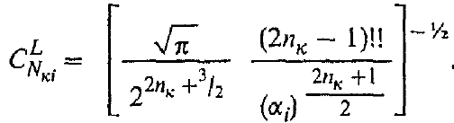


Basis – Gaussian Type Orbitals (GTOs)
The normalisation factors are given by
The exponents are generated according to
where α₀ and β are input parameters.

Slide 17

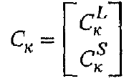


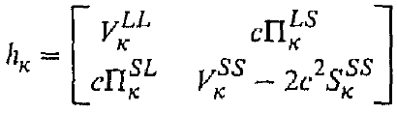
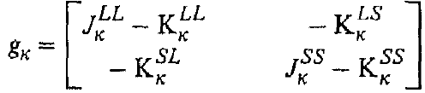
Matrices
The matrices are block diagonalised according the symmetry type κ.
The Fock Matrix is of 2N_{κ}×2N_{κ} dimension.
The Fock has two contributions
One electron operator
Coulomb repulsion term

Slide 18





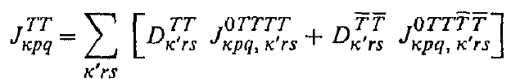








Integrals
For a point nucleus, $V_{nuc}(r)=−\frac{Z}{r}$
and are matrix adjoints of each other.
$$T\overline{T}=LS/SL$$
$$T, T′=L/S$$

Slide 19
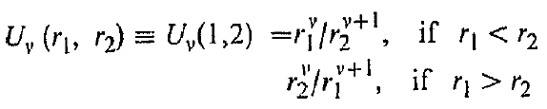

Integrals

Slide 20
Code

Slide 21
Input parameters
Atomic number, atomic mass
Number of symmetries, number of basis and occupied orbitals for each symmetry
α₀ and β for the GTOs.
Maximum number of iterations, critical value to establish convergence.
Check all these parameters for being consistent with each other.

Slide 22
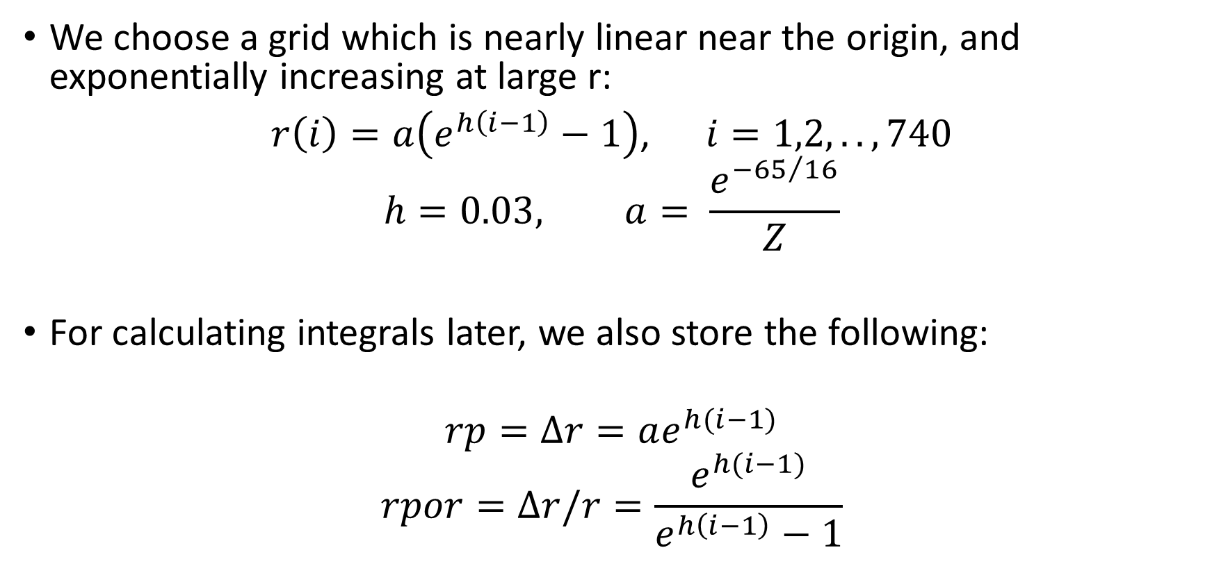
Grid
We choose a grid which is nearly linear near the origin, and exponentially increasing at large r:
$r\left(i\right)=a\left(e^{h\left(i−1\right)}−1\right)$, $i=1,2,..,740$
$$h=0.03, a= \frac{e^{{−65}/{16}}}{Z}$$
For calculating integrals later, we also store the following:
$$rp=∆r=ae^{h(i−1)}$$
$$rpor=∆r/r=\frac{e^{h(i−1)}}{e^{h\left(i−1\right)}−1}$$

Slide 23
Setting Up
Calculate the various g^{L} and g^{S} as a function of r.
Calculate the overlap matrix and the one electron part of the Fock Matrix by calculating the various integrations using 10-point Newton Cotes’ Method.

Slide 24
SCF Procedure
Neglect electron-electron interaction in the first iteration, eq. to P=0
Calculate coulomb repulsion part of Fock matrix if iteration>1.
Diagonalise S to obtain X.
Calculate F’.
Diagonalise F’ to obtain C’.
Calculate C.
Calculate the density matrix. Calculate the norm of the difference between this and the old density matrix. If it is less than the critical value, end the procedure. Otherwise return to step 2 if iter<maxiter.
If iter>=maxiter, equations didn’t converge.

Slide 25
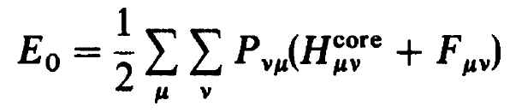
Calculating total energy
Total Energy is calculated using the following relation:

Slide 26
Problems
Unable to get the SCF procedure to converge.
Future Objectives
Check the code for errors which might lead to divergence.
Try eliminating basis for which eigenvalues of the overlap matrix are too small.
Add other features like different types of basis, Breit interaction, finite nuclei, isotope shift, correlation energy using post mean field methods and open shell calculations

Slide 27
References
Nataraj, H. S., Notes, Unit-1 Many electron atoms, PHN-626 Advanced Atomic and Molecular Physics (2021), IIT Roorkee.
Szabo, A., & Ostlund, N. S. (1996). Modern quantum chemistry: Introduction to advanced electronic structure theory.
Clementi, E., Modern Techniques in Computational Chemistry: MOTECC-91, Chapter 4.
Nataraj, H. S.,DF SCF.F90 Fortran Code.

Slide 28
Thank You.

